Slide 1
CHATBOT IN DIALOGFLOW
Team Details
A. Rajesh(20EG105103)
B. Srujana(20EG105106)
D. Nitisha(20EG105110)
T. Karthik(20EG105150
Project Supervisor
Mr .P. Raja Sekar Reddy
Assistant Professor

Slide 2
Introduction
Chatbots have become an integral part of the digital landscape, enhancing user interactions and providing efficient and personalized services. Dialogflow, a powerful natural language processing (NLP) platform developed by Google, allows developers to create intelligent chatbots that can understand and respond to user inputs in a conversational manner.
In the context of the food industry, a Dialogflow chatbot can be designed to assist users with various tasks related to food ordering, recommendations, menu inquiries, and more.
Current fooddelivery applications may present challenges such as cumbersome navigation, limited personalization, and a lack of interactive assistance. Users often face difficulties in expressing their food preferences, finding.

Slide 3
Problem Statement
The food delivery industry is a dynamic and rapidly evolving sector that relies heavily on technology to enhance user convenience. While many food delivery platforms exist, the user experience often involves navigating through complex interfaces and menus, leading to potential frustration and inefficiency. There is a compelling need for an intelligent and user-friendly chatbot solution to simplify the food ordering process, provide personalized recommendations, and create a seamless interaction between users and the food delivery service.
The primary objective is to develop a Chatbot using Dialogflowthat can serve as an efficient intermediary between users and the food delivery service. The Chatbot should be capable of understanding natural language queries, assisting users in finding suitable restaurants, providing menu information, handling order customization, and ultimately facilitating a smooth and personalized food ordering experience

Slide 4
Proposed Method
Chatbot is designed to facilitate food ordering, tracking, and customization through an intuitive and user-friendly interface. Users can effortlessly place new orders, modify existing ones, track their order status, and interact with the chatbot in a conversational manner. Leveraging the power of Dialogflow, the chatbot comprehends user queries, extracts relevant information, and seamlessly integrates with a backend system to process orders and manage user data.
Connect to SQL Database:
Set up database connections in the backend to interact with the SQL database.
Use an ORM(Object-Relational Mapping) library if needed.
Implement CRUD Operations:
Implement Create, Read, Update, and Delete (CRUD) operations in the backend to manage data in the SQL database.

Slide 5
Proposed Method Illustration
Frontend Development:
1.Define Frontend Architecture:
Decide on the frontend architecture
2. Set Up Development Environment:
Install necessary development tools and dependencies for your chosen frontend framework.
3.Create User Interface (UI):
Design and implement the user interface for the chatbot, incorporating input fields for user
queries and space to display chatbot responses.
Backend Development:
1.Database Design:
Design the SQL database schema to store user information, order details, and any other
relevant data.
2.Implement Dialogflow Integration:
Develop backend logic to handle Dialogflow interactions, including sending queries to
Dialogflow and processing intent responses

Slide 6
Experiment Environment
1.Development language and framework:
-Natural Language processing
-Python
2.Database:
-MySql database
3.Tools:
-pycham
-Dialogflow
4.front-end:
-HTML and CSS
User Interface

Slide 7
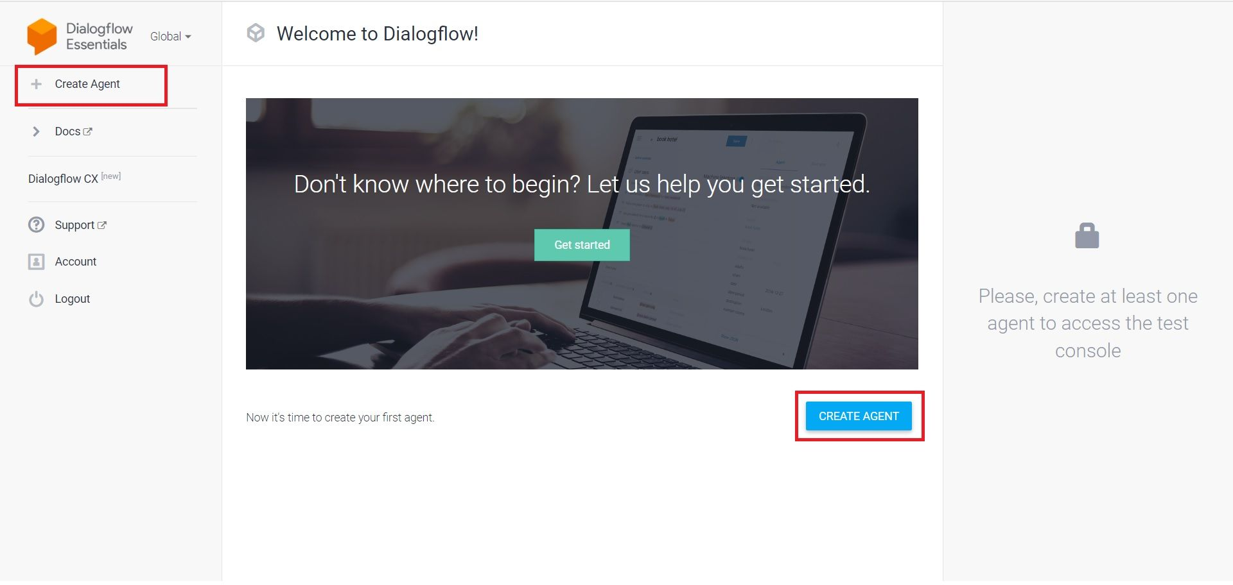
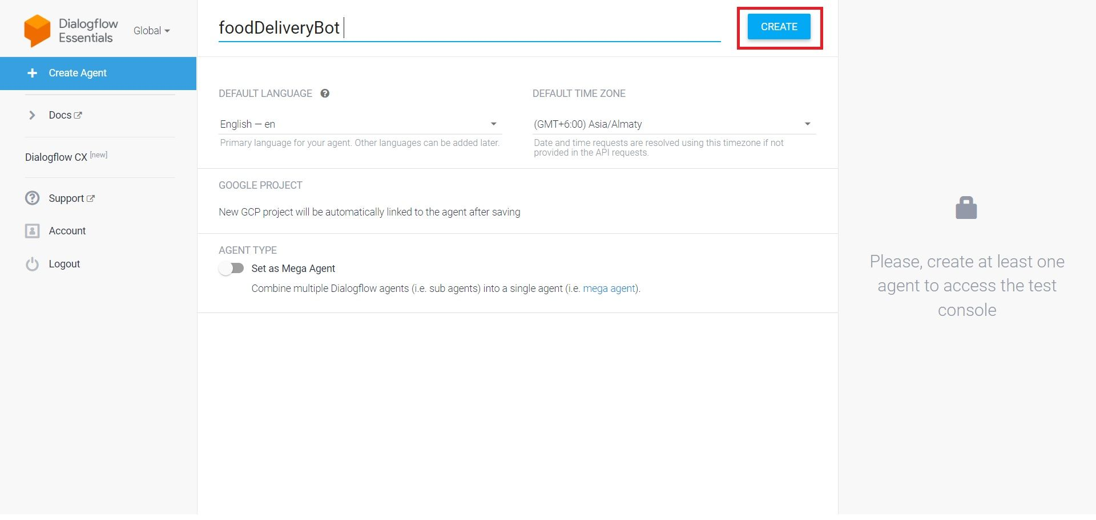
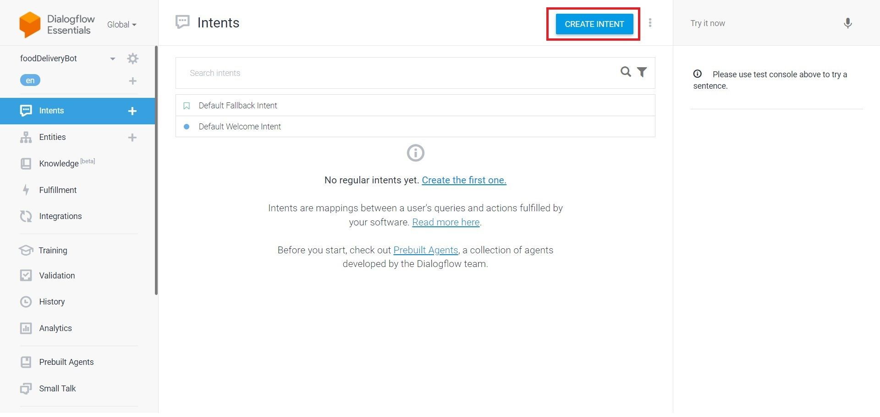
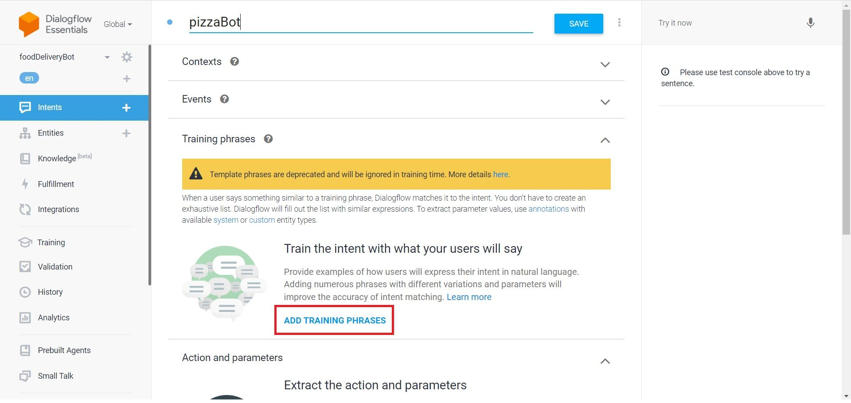
Experiment Screen shorts

Slide 8
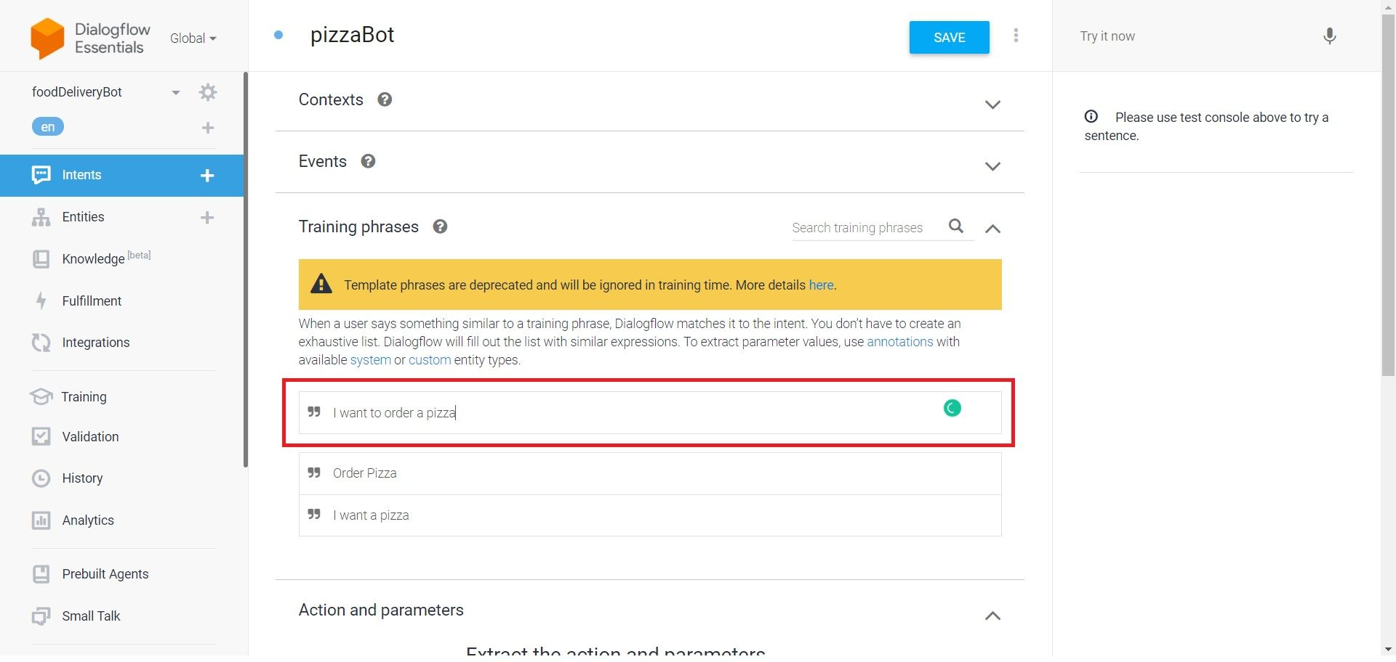
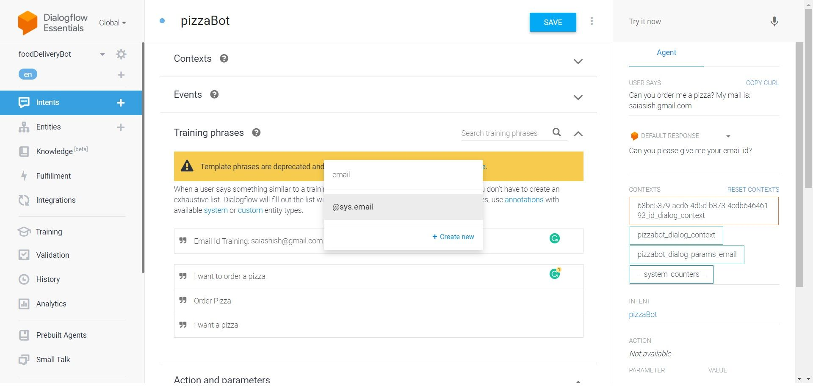
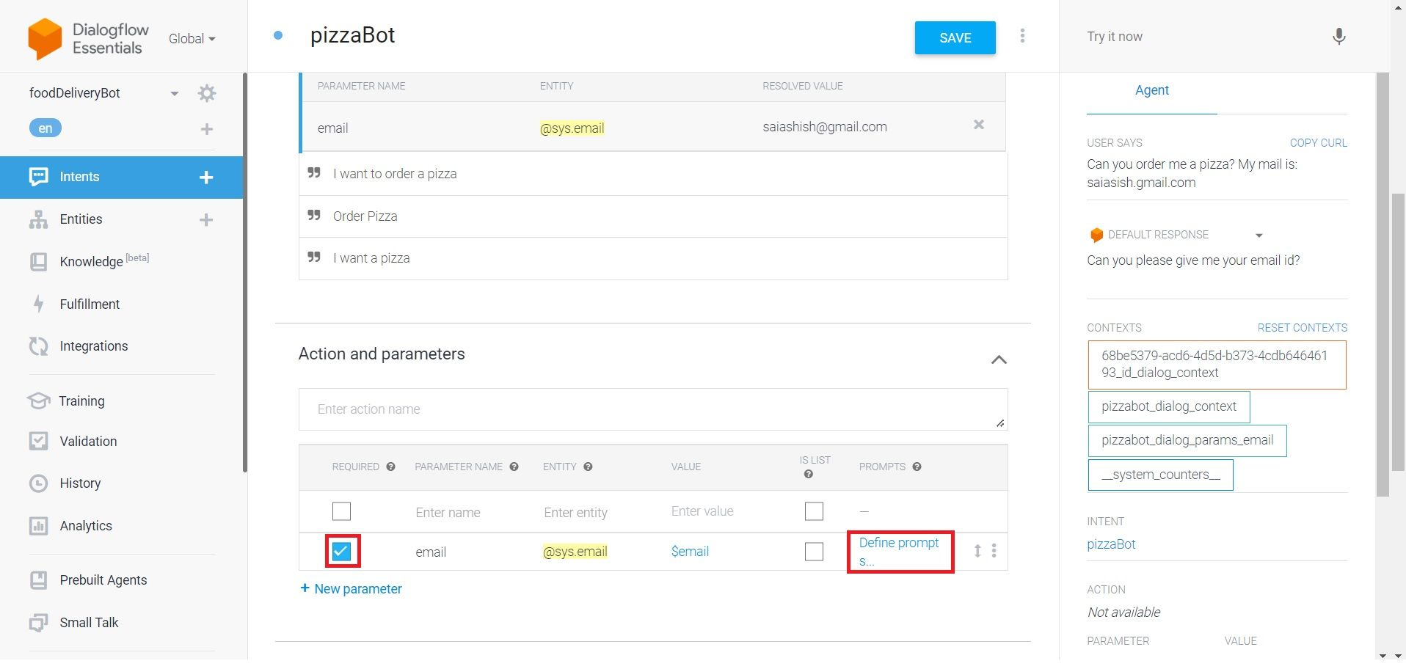
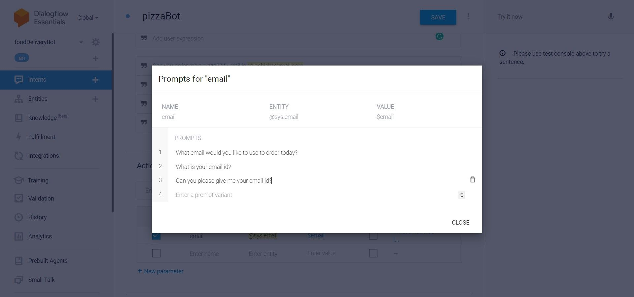
Experiment Screen shorts

Slide 9
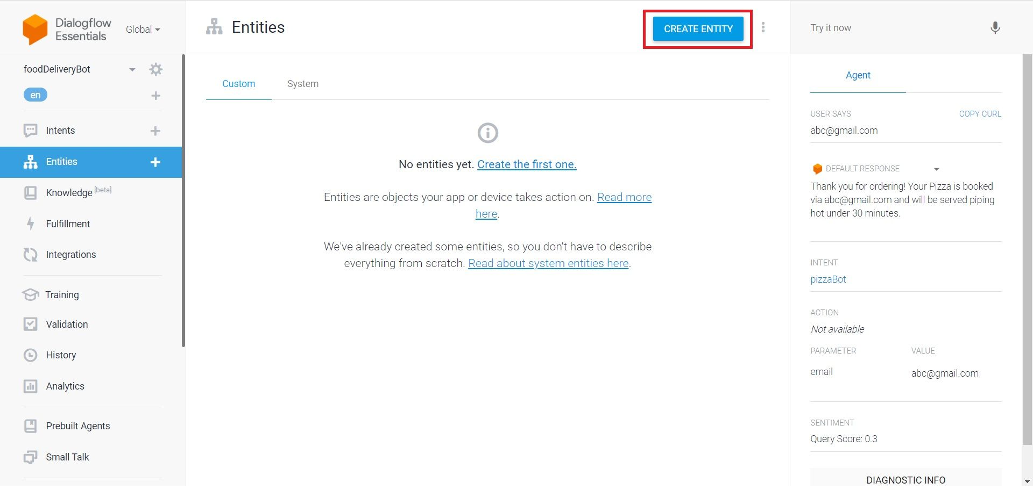
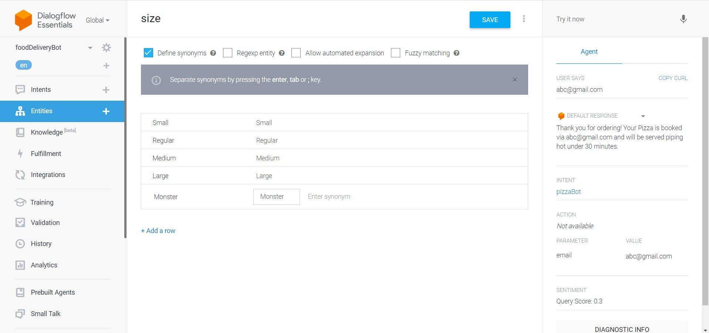
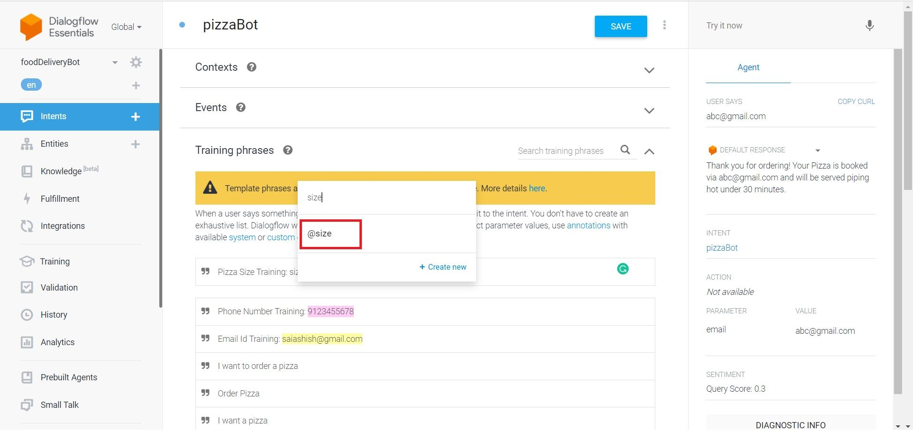
Experiment Screen shorts

Slide 10
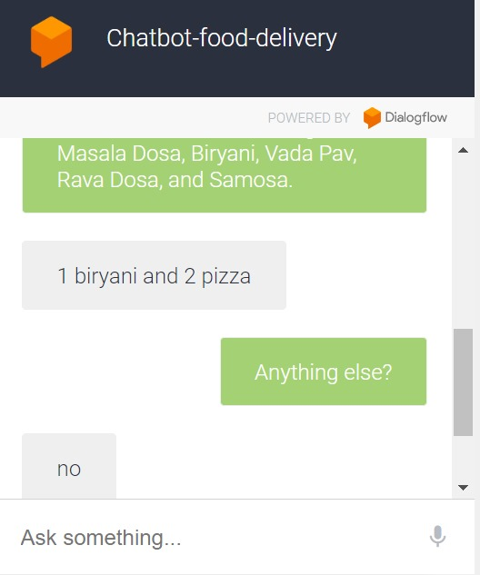
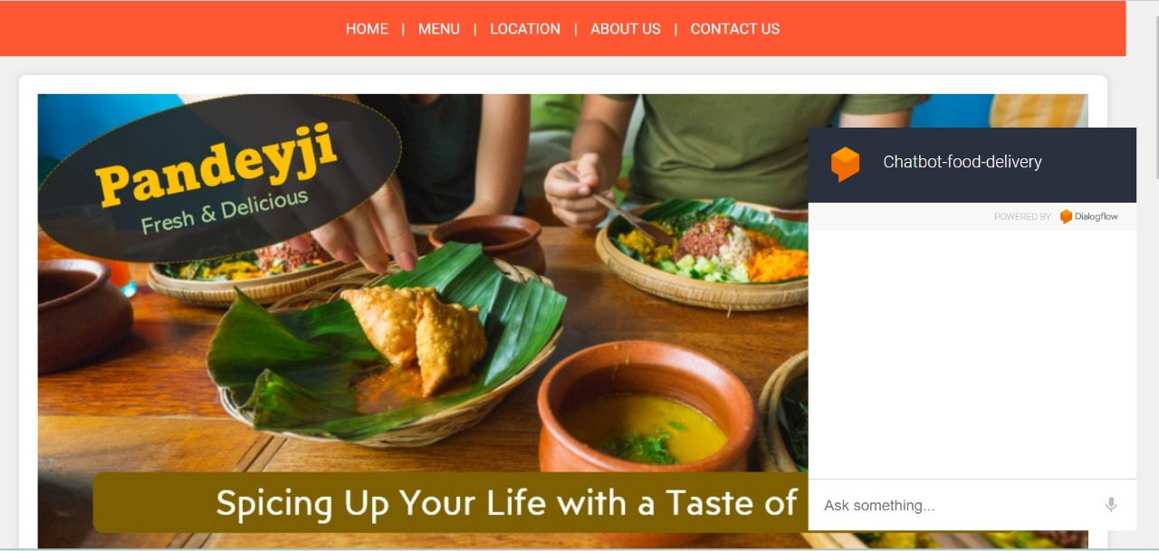
Experiment Results

Slide 11
Finding
Chatbots can improve customer engagement by providing quick and personalized responses to inquiries about menu items, reservations, and restaurant details.
Chatbots can streamline the ordering process by allowing customers to place orders directly through the chat interface, reducing wait times and potential errors.Chatbots can help manage restaurant reservations by allowing customers to check availability, make reservations, and receive confirmation details through the chat interface.
Chatbots can provide menu assistance by offering recommendations based on customer preferences, dietary restrictions, and availability.
Chatbots can collect feedback from customers about their dining experience, which can be used to improve service quality and customer satisfaction.Chatbots can improve operational efficiency by automating repetitive tasks such as answering frequently asked questions and processing simple orders.
Overall, the findings suggest that chatbots in Dialogflow can significantly benefit restaurants by improving customer service, increasing efficiency, and enhancing the overall dining experience.

Slide 12
By providing quick and accurate responses to customer inquiries, chatbots can enhance overall customer satisfaction levels. Chatbots can respond to customer queries instantly, reducing the time customers have to wait for assistance.Chatbots can handle multiple customer inquiries simultaneously, improving the efficiency of customer service operations.Chatbots can help reduce the need for human customer service representatives, leading to cost savings for the restaurant. By automating the order-taking process, chatbots can help reduce errors in orders, leading to improved order accuracy. Chatbots automate customer interactions, allowing for quicker responses and reducing the workload on human staff. This automation leads to faster response times and improved efficiency. Chatbots provide consistent responses to customer inquiries, ensuring that all customers receive the same level of service. This consistency helps improve customer satisfaction levels
Justification

